Slide 1
Capstone Engagement
Assessment, Analysis, and Hardening of a Vulnerable System

Slide 2
Table of Contents
This document contains the following sections:
01
Network Topology
02
Red Team: Security Assessment
03
Blue Team: Log Analysis and Attack Characterization
Hardening: Proposed Alarms and Mitigation Strategies
04

Slide 3
Network Topology
‹#›

Slide 4
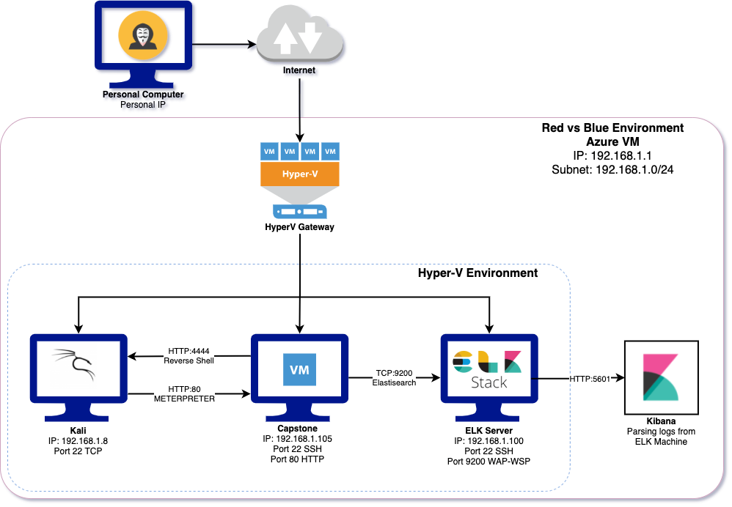
Network Topology
Network
Address Range: 192.168.1.0/24
Netmask: 255.255.255.0
Gateway: 192.168.1.1
Machines
IPv4:192.168.1.1
OS: Windows 10 Pro
Hostname: ML-RefVm-958751
(Azure VM)
IPv4: 192.168.1.8
OS: Kali Linux
Hostname: Kali
IPv4: 192.168.1.105
OS: Ubuntu Linux
Hostname: Ubuntu-Headless (ELK)
IPv4: 192.186.1.100
OS: Ubuntu Linux
Hostname: server1 (Capstone)

Slide 5

Red Team
Security Assessment
‹#›

Slide 6
Recon: Describing the Target
Nmap identified the following hosts on the network:
Hostname | IP Address | Role on Network
ML-RefVm-958751 (Azure VM) | 192.168.1.1 | Gateway
Kali Linux (Kali) | 192.168.1.8 | Pentesting Machine
server1 (Capstone) | 192.168.1.105 | Target Machine running Apache Web Server
Ubuntu-Headless (ELK) | 192.168.1.100 | Monitoring network security

Slide 7
Vulnerability Assessment
The assessment uncovered the following critical vulnerabilities in the target:
Vulnerability | Description | Impact
Unprotected Credential Information | Employee usernames were visible on the web server. | Knowing a username assisted the pentester in gaining access via brute force attack.
Security Misconfiguration | Unknown IP addresses are allowed to access secure folders on the server. | The pentester was able to access the /secret_folder and /webdav, and all files contained therein.
Unauthorized File Upload | No protections are in place to stop any user from uploading files to WebDAV. | Pentester was able to upload and execute a .php file into the WebDav folder.
Unauthorized File Execution | Files can be executed from within WebDAV. | The .php file was executed from within WebDAV which facilitated a reverse shell.

Slide 8
Exploitation: Sensitive Data Exposure
01
02
Tools & Processes
An NMAP scan found the IP address of the target machine (server1) to be 192.168.1.105 with an open HTTP port 80.
Achievements
Using a web browser (FireFox), I was able to gain access to publicly available folders on the web server.

Slide 9
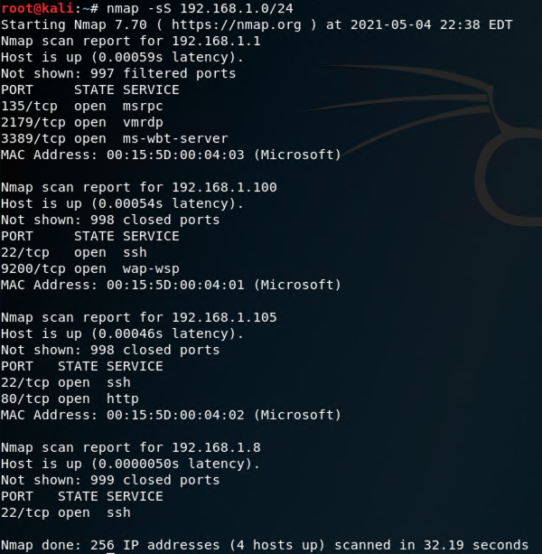
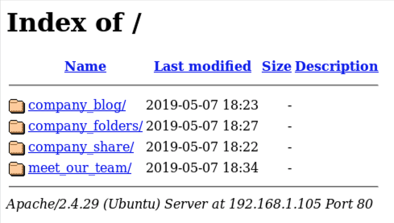
Exploitation: Sensitive Data Exposure
03

Slide 10
Exploitation: Directory Structure Exposure
01
02
Tools & Processes
Using FireFox the pentester was able to view and navigate the directory structure of the web server
Achievements
The directory structure was mapped and files containing further structural data were included. Namely the address of /secret_folder.

Slide 11
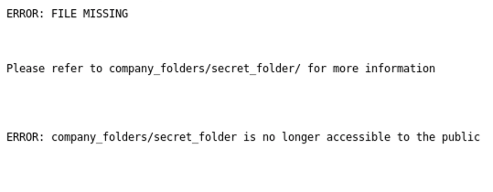
Exploitation: Sensitive Data Exposure
03

Slide 12
Exploitation: Unprotected Credential Information
01
02
Tools & Processes
Attempting to access /secret_folder via the web browser revealed and administrative username in the sign in pop-up.
Achievements
By simply checking the access to the /secret_folder directory the pentester was able to find an administrative username Ashton.

Slide 13
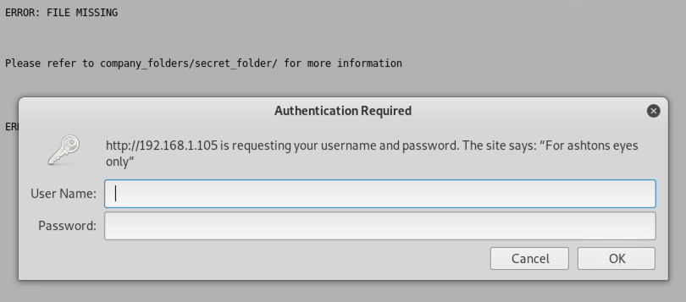
Exploitation: Unprotected Credential Information
03

Slide 14
Exploitation: Brute Force Attack
01
02
Tools & Processes
Using the Kali Linux tool, Hydra, the pentester was able to brute force the password for user Ashton and gain access to /secret_folder.
Achievements
Brute force was used to find the password for user Ashton.
Using those credentials, access to /secret_folder was gained.
Location information and access instructions for /webdav were contained within /secret_folder. Username Ryan and an associated password hash were included.

Slide 15
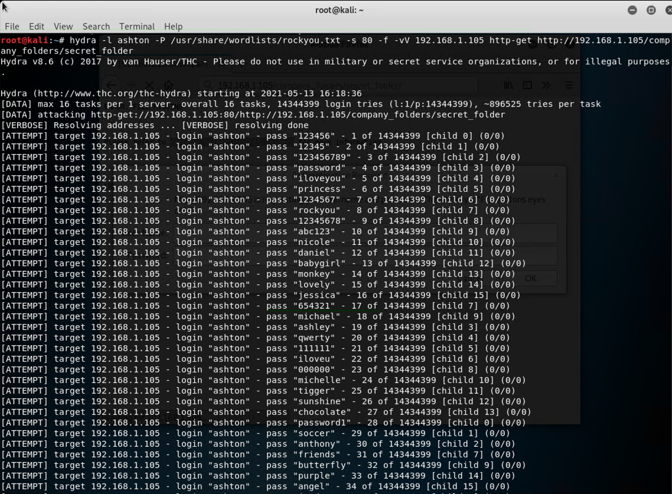
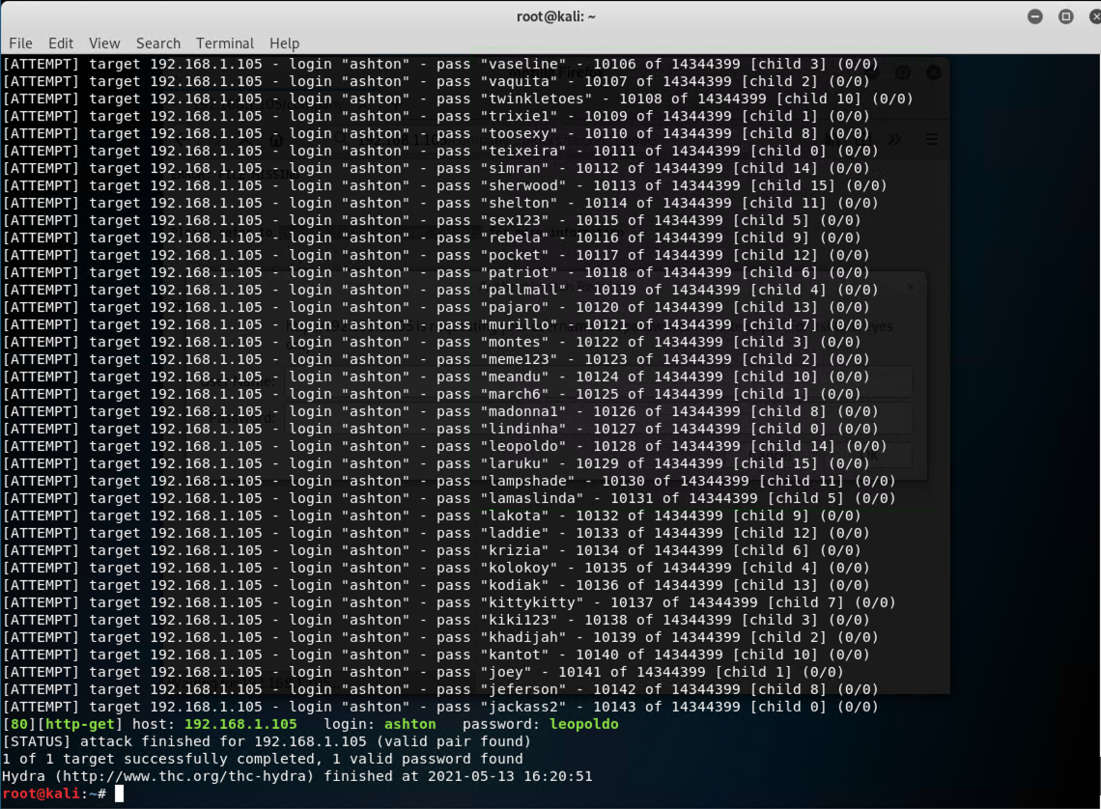
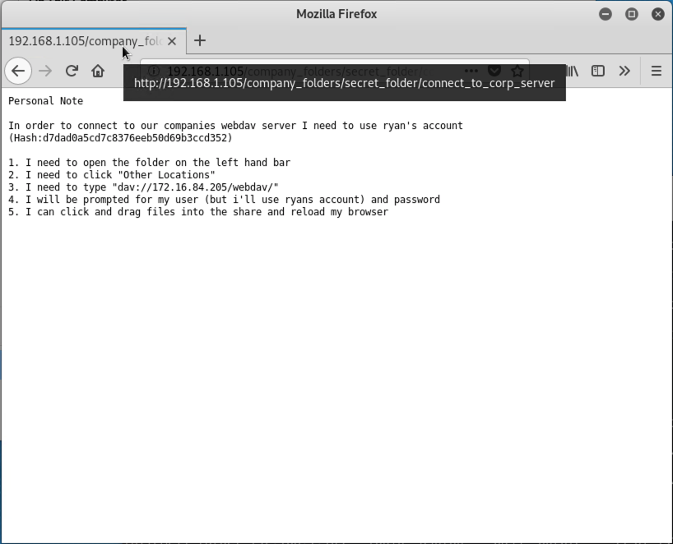
Exploitation: Brute Force Attack
03

Slide 16
Exploitation: Security Misconfiguration
01
02
Tools & Processes
Using a web browser the pententer was able to access the directories on the web server.
Achievements
Accessing the directories and on the web server gave the pentester further information the was used to access additional company resources including:
/company_folders /company_folders
/secret_folder
WebDAV

Slide 17
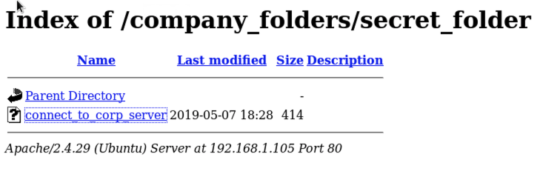
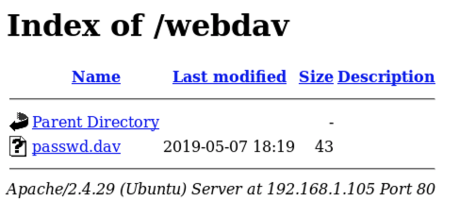
Exploitation: Security Misconfiguration
03

Slide 18
Exploitation: Security Misconfiguration
01
02
Tools & Processes
The username Ryan was found. Along with it were instructions on how to access WebDav and Ryan’s hashed password. The hash was entered into the publicly available hash cracking website, crackstation.net, and the password was revealed.
Achievements
The combination of the exposed username and the cracked password allowed administrative access to WebDAV.

Slide 19
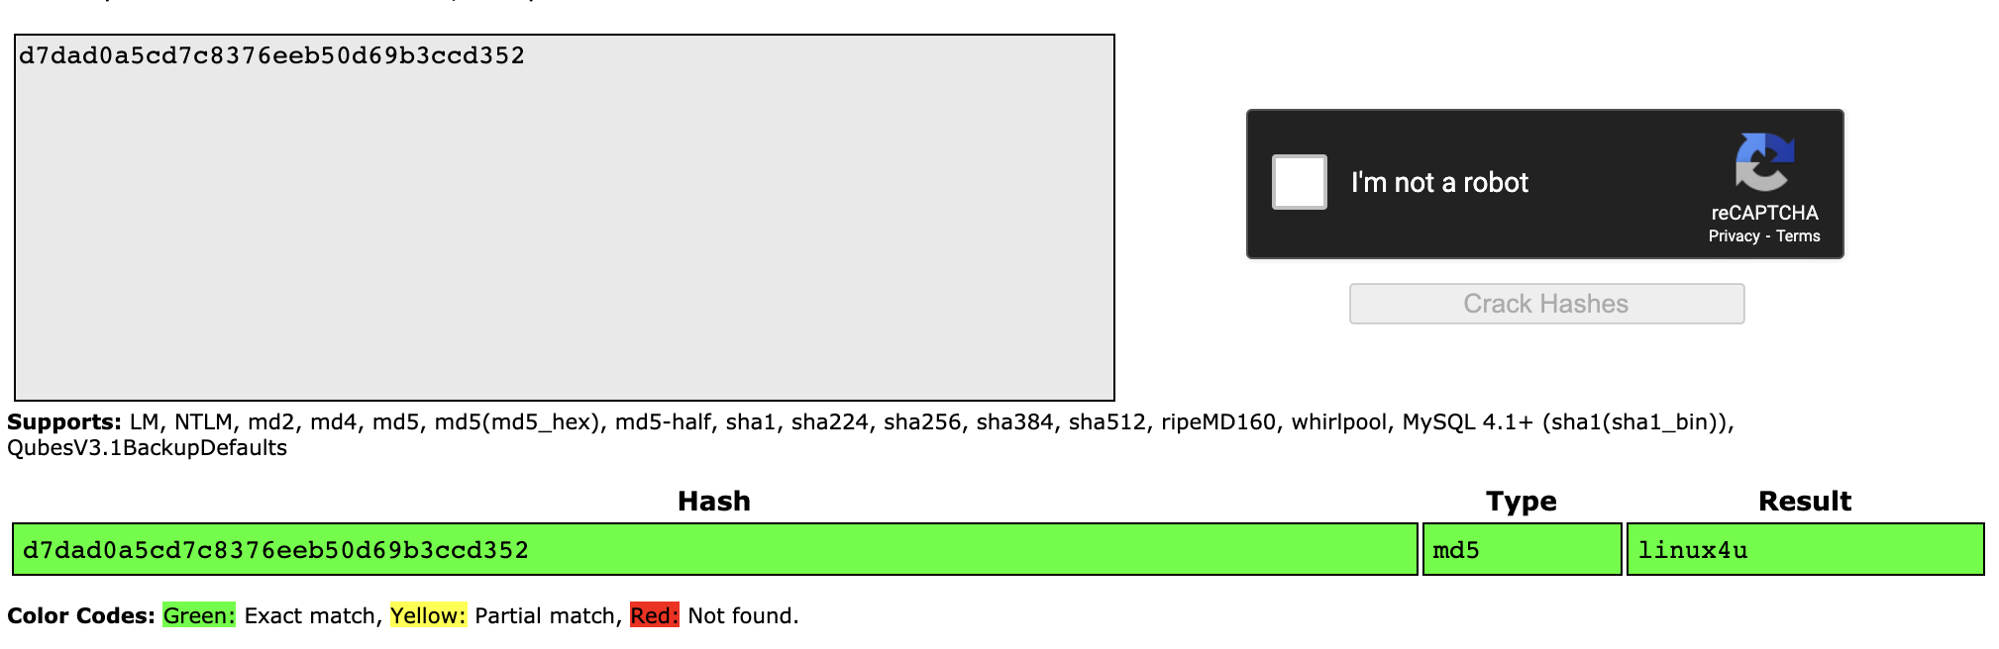
Exploitation: Security Misconfiguration
03

Slide 20
Exploitation: Unauthorized File Upload
01
02
Tools & Processes
Using msfvenom a .php reverse_tcp script was created and uploaded to /webdav.
Achievements
The pentester was able to insert a malicious file into WebDAV.

Slide 21
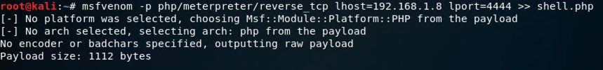
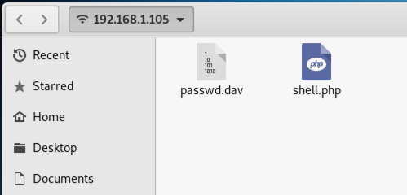
Exploitation: Unauthorized File Upload
03

Slide 22
Exploitation: Unauthorized File Execution
01
02
Tools & Processes
Opening WebDAV within a web browser, the pentester was able to execute the .php file.
Metasploit meterpreter was then used to access and create a shell on the target machine, server1 (Capstone).
Achievements
Access to the target machine was gained through the use of meterpreter and a reverse shell was generated.
Command and control (C2) was achieved, and the flag.txt file was captured

Slide 23
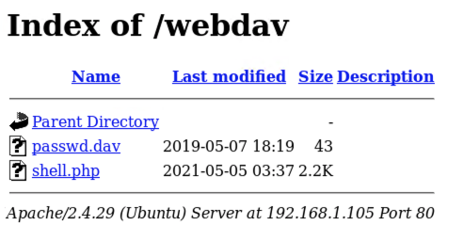
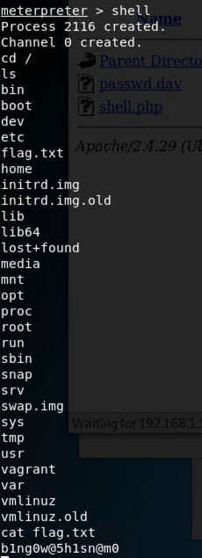
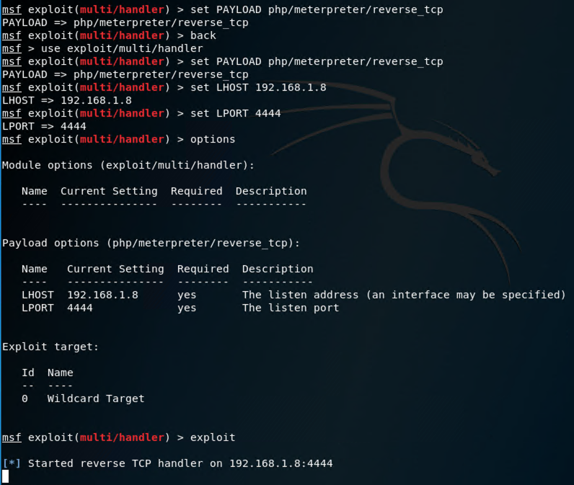
Exploitation: Unauthorized File Execution
03

Slide 24

Blue Team
Log Analysis and Attack Characterization
‹#›

Slide 25

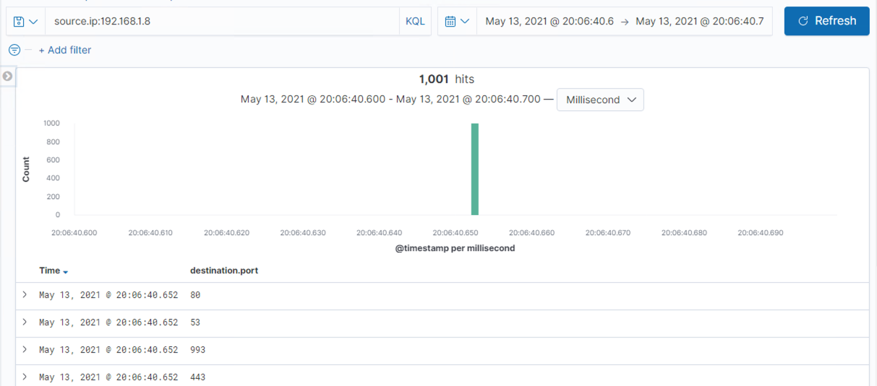
Analysis: Identifying the Port Scan
A port scan occurred at 20:06:40:652 on May 13, 2021.
1,001 packets were sent.
Packets were sent from a single IP contacting all ports in one millisecond indicating this was a port scan.

Slide 26
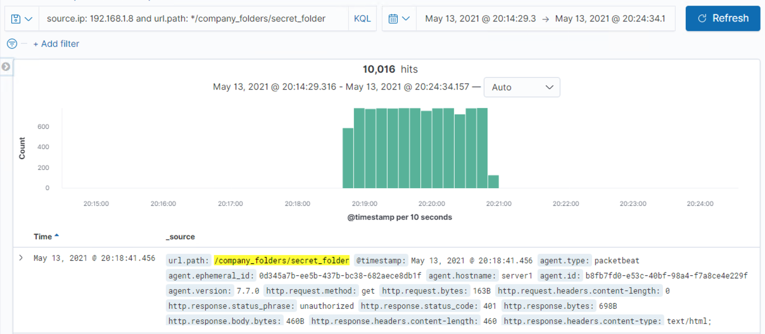
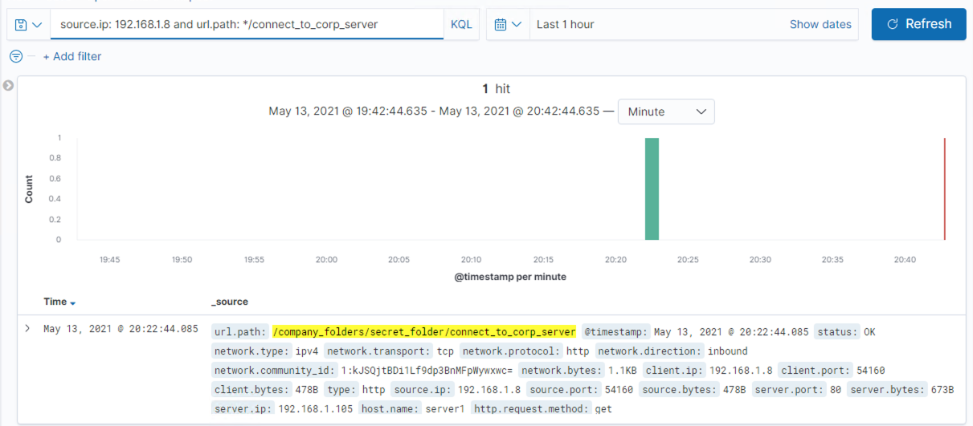
Analysis: Finding the Request for the Hidden Directory
The first request made to /secret_folder was made at 02:18:41.456 on May 13, 2021. Requests totalled 10,016.
The /connect_to_corp_server file was accessed, which contained instructions to access /webdav as well as a password hash for user Ryan.

Slide 27
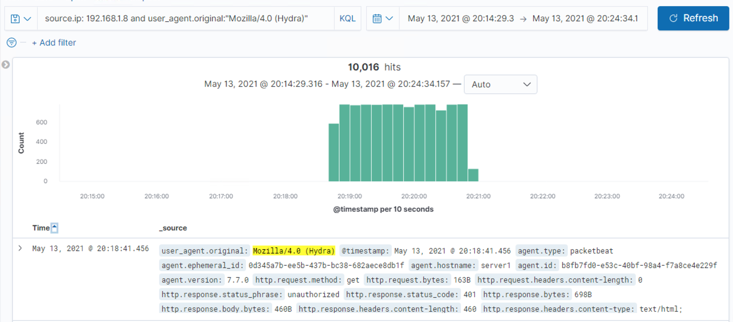
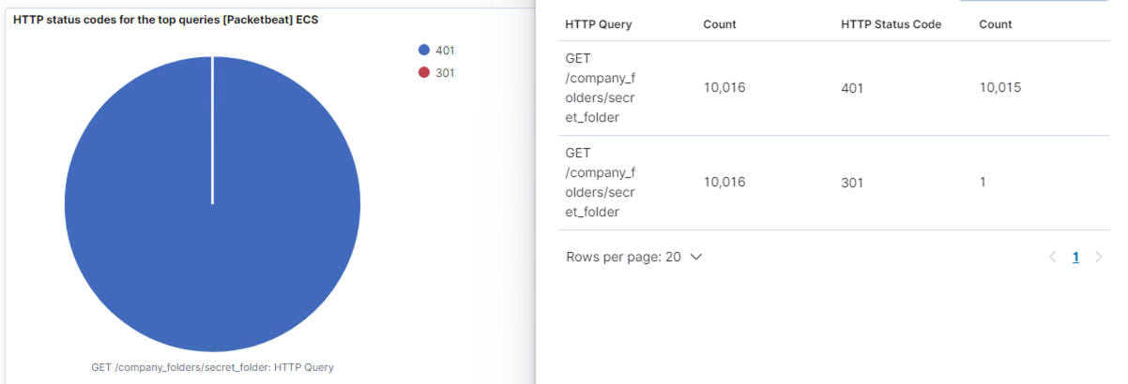
Analysis: Uncovering the Brute Force Attack
Starting at 20:18:41.456 on May 13, 2021 a total of 10,016 requests were sent to the /secret_folder directory using Hydra.
After 10,015 requests were made, the attack was successful and the password was discovered.

Slide 28
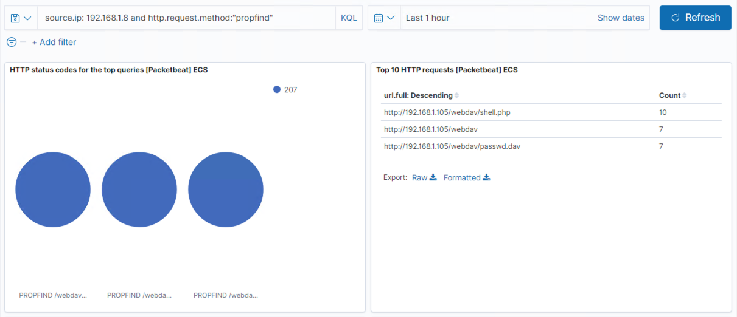
Analysis: Finding the WebDAV Connection
A total of 24 requests were made to connect to the webdav directory.
Requests were made to access the passwd.dav and shell.php files.

Slide 29
Blue Team
Proposed Alarms and Mitigation Strategies
‹#›

Slide 30
Mitigation: Blocking the Port Scan
What kind of alarm can be set to detect future port scans?
An alarm should be set for a high number of non-HTTP ports being scanned.
What threshold would you set to activate this alarm?
The SOC should be notified if greater than 5 errors occur per minute on a non-HTTP port.
What configurations can be set on the host to mitigate port scans?
The firewall should be configured to block all incoming/outgoing traffic on all ports except 80 with a whitelist for necessary access. The following iptable rules will also help prevent port scans from returning results:
iptables -A INPUT -p tcp –tcp-flags ALL NONE -j DROP
iptables -A INPUT -p tcp –tcp-flags SYN,FIN SYN,FIN -j DROP
iptables -A INPUT -p tcp –tcp-flags SYN,RST SYN,RST -j DROP

Slide 31
Mitigation: Finding the Request for the Hidden Directory
What kind of alarm can be set to detect future unauthorized access?
Alarm should be set to alert if access to sensitive data is attempted.
What threshold would you set to activate this alarm?
The SOC should be alerted in the case of attempts to access sensitive files or directories.
What configuration can be set on the host to block unwanted access?
Multi Factor Authentication should be employed to protect sensitive files and directories.
Additionally, IP addresses that need access to sensitive files or directories can be set up in Linux with the following commands:
iptables -I INPUT -s SUBNET_HERE -p tcp -m multiport --dports 80,443 -j ACCEPT
iptables-save > /etc/firewall.conf

Slide 32
Mitigation: Preventing Brute Force Attacks
What kind of alarm can be set to detect future brute force attacks?
Kibana should be set to detect a large number of failed login attempts that originate from the same IP within a short time period. An alert should also be set to detect the use of Hydra or similar known brute force tools.
What threshold would you set to activate this alarm?
The alarm should be triggered by greater than five failed login attempts in a minute and/or the use of known brute force tools.
What configuration can be set on the host to block brute force attacks?
Most importantly, a strong password policy can help prevent successful brute force attempts.
Adding multi factor authentication (MFA) creates an additional obstacle for those attempting brute force attacks.

Slide 33
Mitigation: Detecting the WebDAV Connection
What kind of alarm can be set to detect future access to this directory?
Alarm should be set to alert if access to sensitive data is attempted.
What threshold would you set to activate this alarm?
Any attempts to access WebDAV will trigger the alarm.
What configuration can be set on the host to control access?
Multi Factor Authentication should be employed to protect WebDAV.
Necessary IP addresses can also be whitelisted using the same commands as blocking access to hidden directories. Alternately, the “IP Address and Domain Restrictions” for WebDAV can be configured to whitelist select IPs.

Slide 34
Mitigation: Identifying Reverse Shell Uploads
What kind of alarm can be set to detect future file uploads?
The alarm should be set to detect an attempt by non-whitelisted IPs to alter a file on the web server. Additionally another alarm should detect non-whitelisted IPs requesting an HTTP method PUT.
What threshold would you set to activate this alarm?
Any attempts from non-whitelisted IPs to alter files or a PUT HTTP request should notify the SOC.
What configuration can be set on the host to block file uploads?
All anti-virus/malware applications should be kept up to date, and the the firewall can be set up for deep packet inspection to detect suspicious outbound communications.
Additionally, WebDAV should be configured to deny file execution by adjusting permissions under “Handler Mappings”, and employees also need to be educated about the dangers of executing files they have received.

